Slide 1


Global Airline Network Analysis
Cai Xue
Cheng Huaihui
Luo Sijia
Tang Yuqun

Slide 2

1
BACKGROUND
2
DATA INTRODUCTION
3
RESEARCH QUESTIONS
4
NETWORK ANALYSIS

Slide 3
BACKGROUND
1

Slide 4


BACKGROUND
In today’s globalized world, airplanes are playing an increasingly essential roles as major transportation for human and commercial goods.
This advanced transportation technology brings the convenience of trade and boosts mobility of people.

Slide 5
DATA INTRODUCTION
2

Slide 6
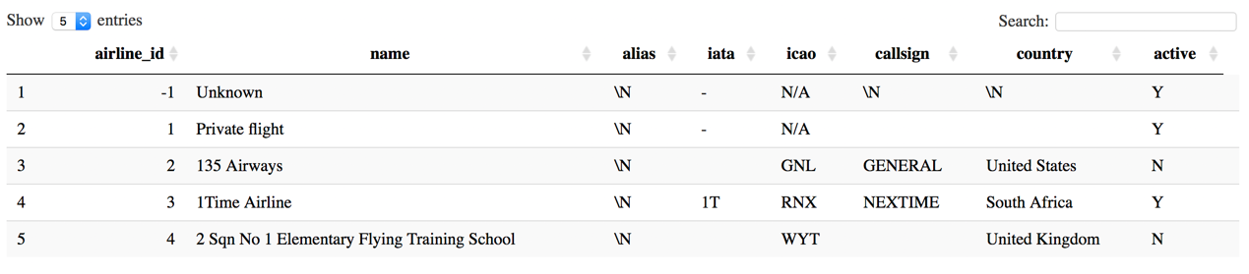
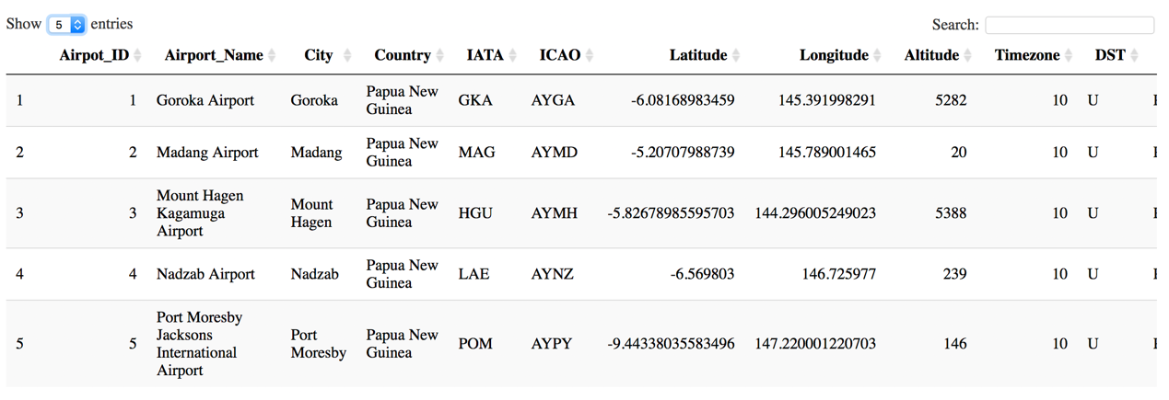
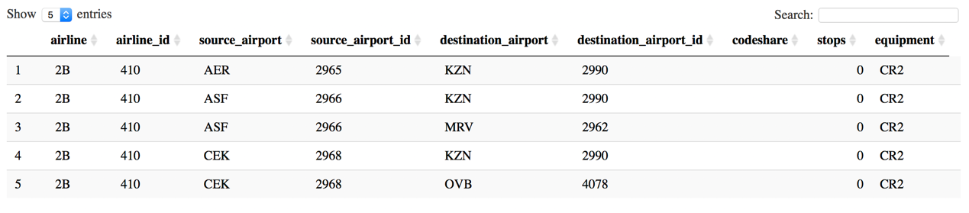
DATA INTRODUCTION
Airline
Airport
Routine

Slide 7
RESEARCH QUESTIONS
3

Slide 8

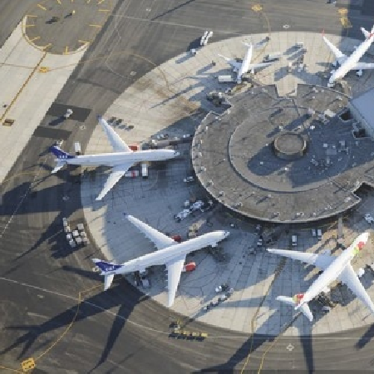
RESEARCH QUESTIONS
What is the distribution of global airports/airlines?
Which country has the most airports/airlines?
What is the relationship between the number of airports and airlines?
The distribution of airlines from or to Singapore?

Slide 9
NETWORK ANALYSIS
4

Slide 10
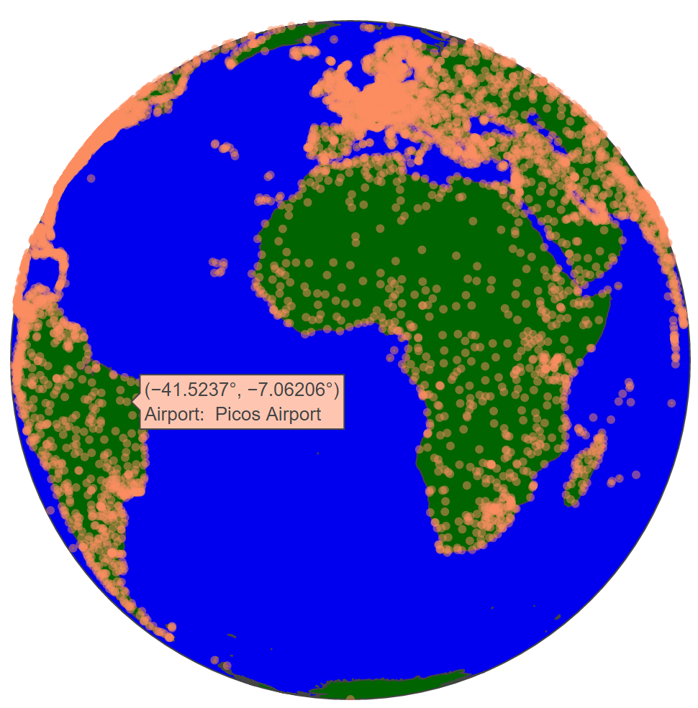
Global Airports Distribution
NETWORK ANALYSIS
7750 airports on the earth in the year of 2007

Slide 11
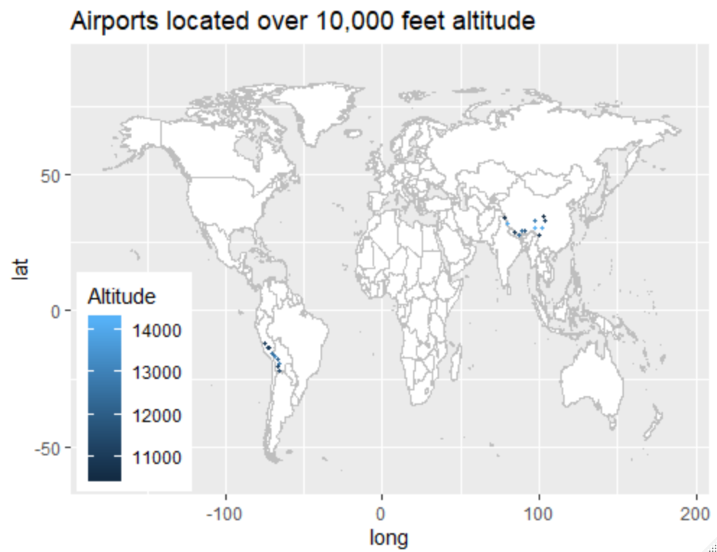
Airports Located Over 10,000 Feet Altitude Distribution
NETWORK ANALYSIS
22 airports located over 10,000 feet

Slide 12
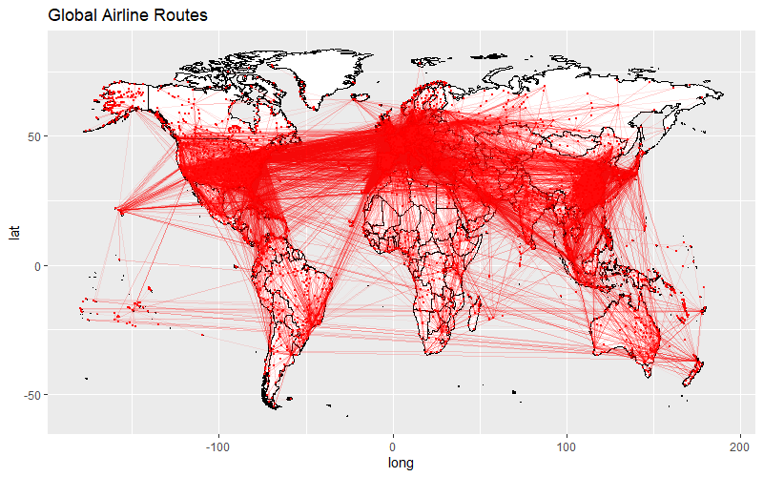
NETWORK ANALYSIS
Europe, South America and East Asia have really busy airline traffic
1 mistake: No line plots across Pacific Ocean

Slide 13
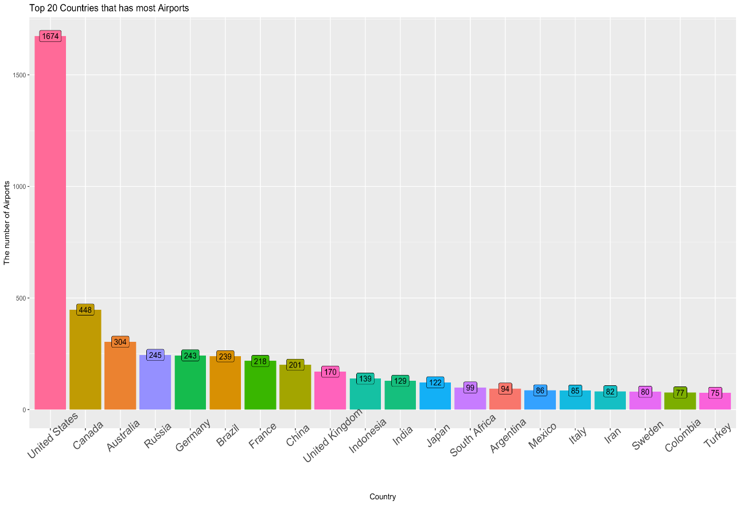
NETWORK ANALYSIS
Which country has the most airports?
United States has by far the most airports.
Territories
Economy
…

Slide 14
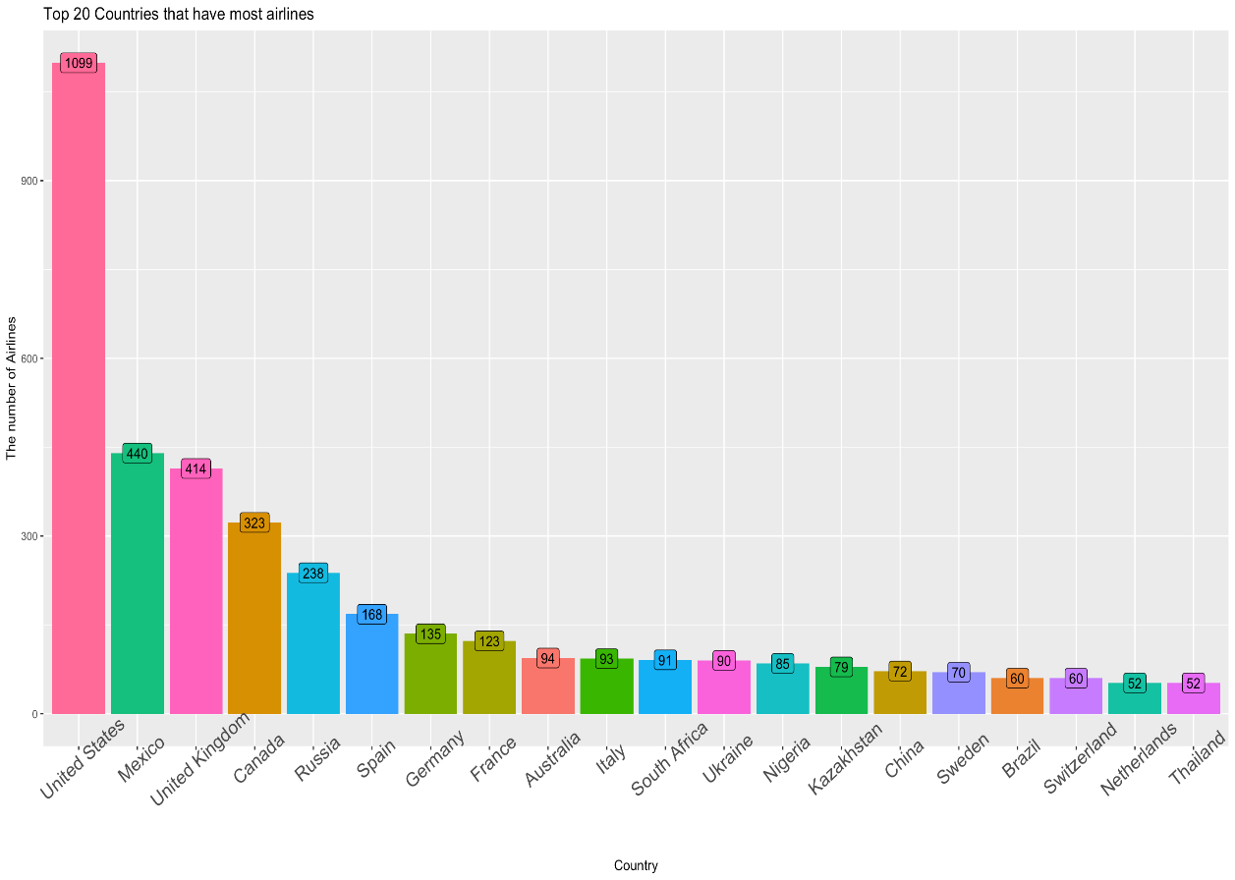
NETWORK ANALYSIS
Which country has the most airlines?
United States has by far the most airlines.

Slide 15

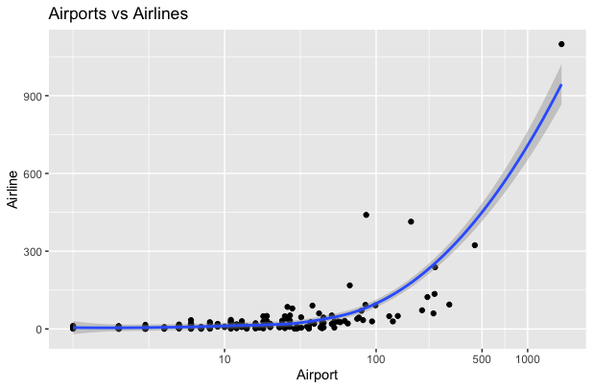
Relationship between Airports and Airlines
There is a positive correlation between the number of airport and airline

Slide 16
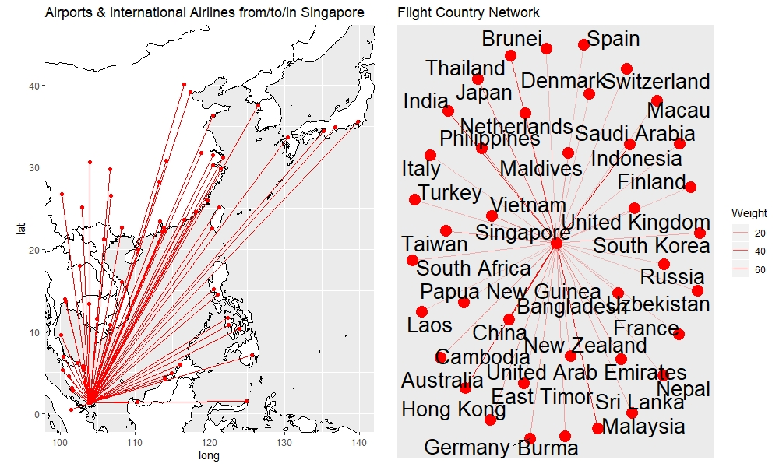
Flight engaging Singapore (Focus on Singapore)
NETWORK ANALYSIS
Overall, there are 121 airports have flights to Singapore.
The countries in Asia have the most flight to Singapore compared to the countries in other continent.
There is an exception: Australia
Direct flights are mainly over the Pacific Ocean because of the short distance.

Slide 17
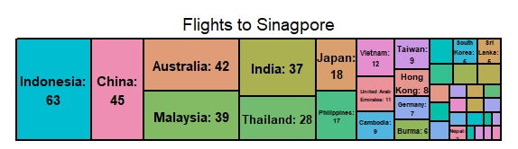
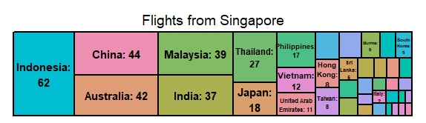
Tree map of the frequency of the flights between one country and Singapore.
NETWORK ANALYSIS

Slide 18
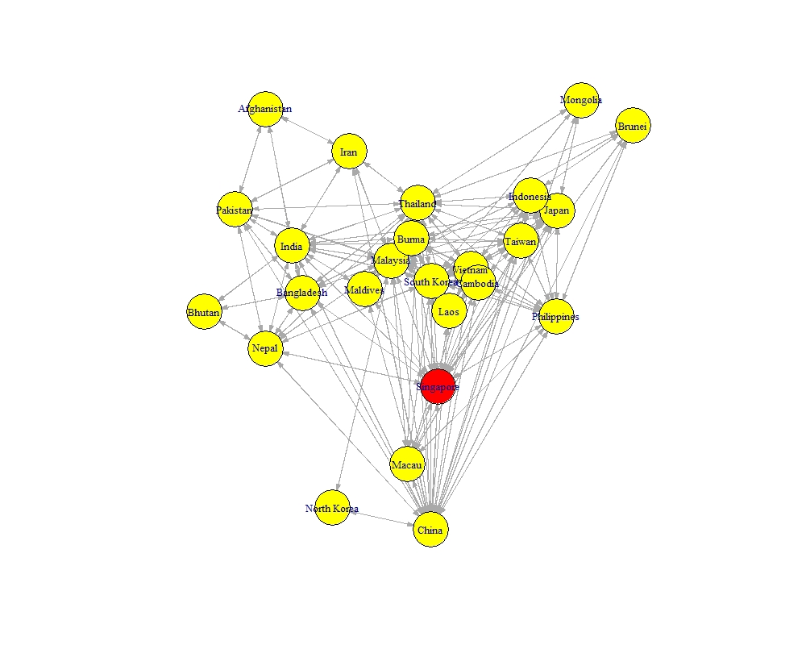
Asia flight network
NETWORK ANALYSIS
The transportation connections among countries in Asia are frequent and complex.

Slide 19


